Slide 1
2. Character segmentation

Slide 2
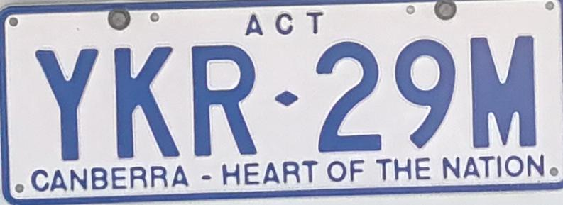


Slide 3
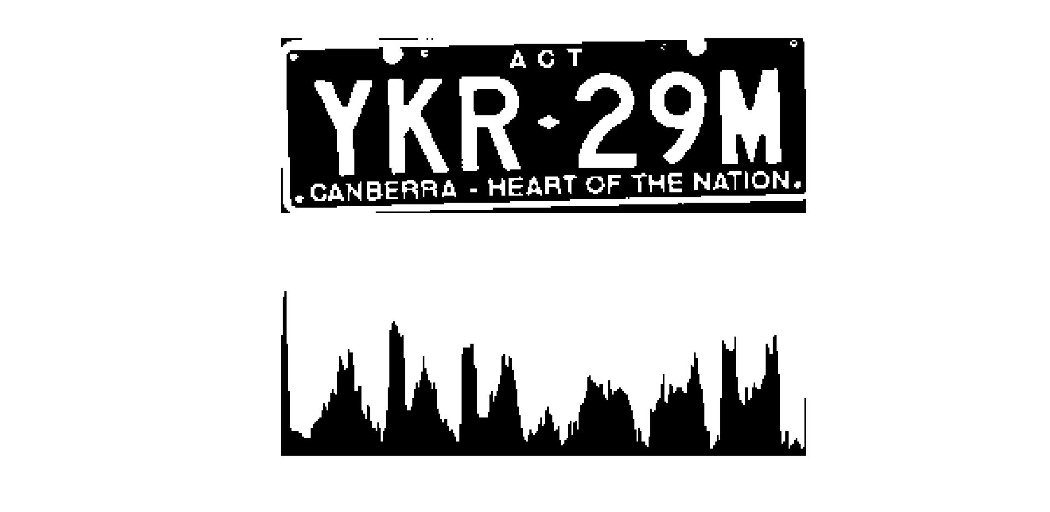
Main idea: Projection based on horizontal coordinate axes

Slide 4
Algorithm:
1. Start from normalized binary image, calculate horizontal projection for each column.
2. Iteration for searching valid parameters( peaks’ max, peaks’ length, threshold) to get 6 peaks.
3. Traversing the horizontal projection, judge whether it’s inside or outside a character, record the start position and the end position.
4. For each 6 peaks, output separated characters for the plate.

Slide 5
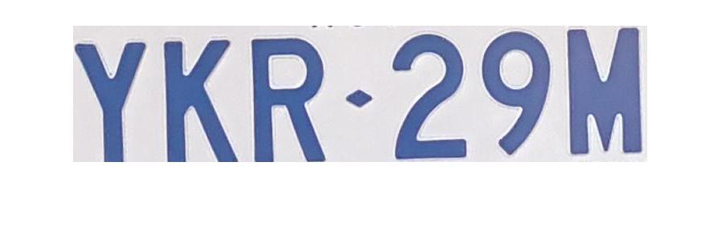
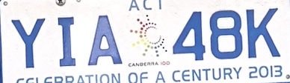

Further improvement
1. Calculate vertical projection
remove ”ACT” and ” heart of the nation”
2. Fitting special style plates and shaded plate

Slide 6

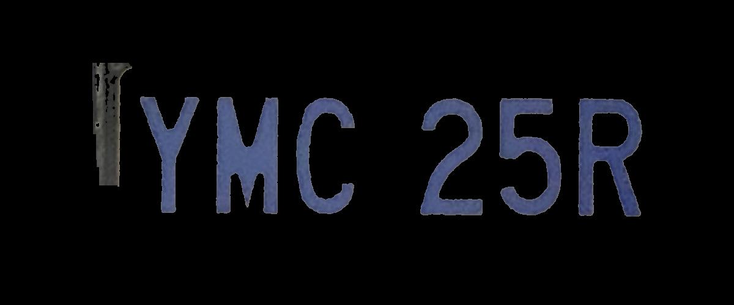

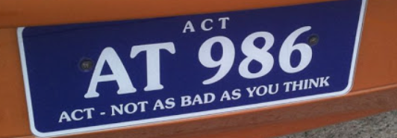
Further improvement
3. Noise and outlier recognition
4. Error and exception report

Slide 7
Q&A

